Slide 1

Interactive Proof Public Coin
Instructor: Kuan Cheng

Slide 2
Interactive Proof
Public Coin vs. Private Coin
Properties of AM
Simulating Private Coin

Slide 3



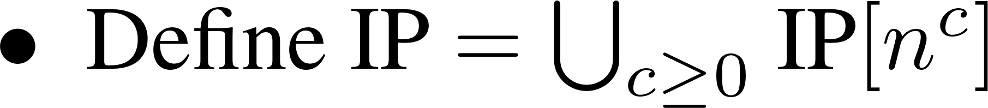

Recall IP with private coin

Slide 4
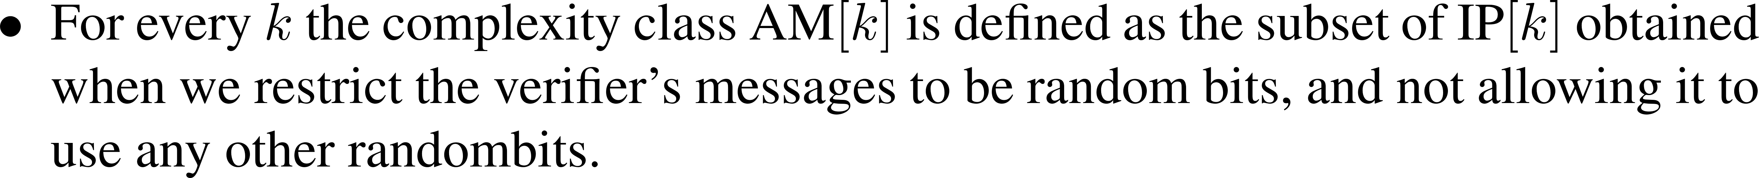


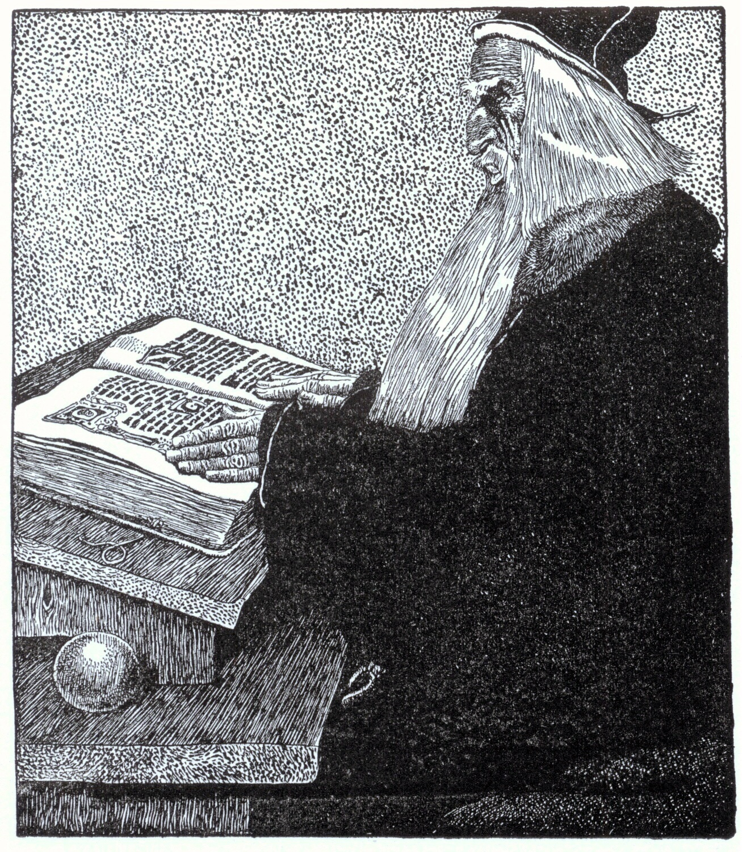
Definition of AM

Slide 5

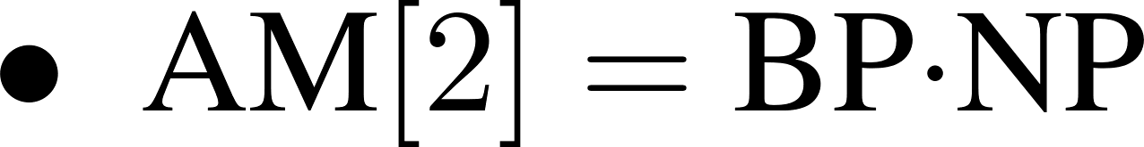

Properties

Slide 6
Simulating Private Coin
Private coin protocols can simulate public coin but how can we do the reverse?
Actually IP[k] is a subset of AM[k+2] (Goldwasser-Sipser 87)
Start from some example. How about IP for GNI?
Recall the protocol

Slide 7



Graph Non-Isomorphism

Slide 8




Graph Non-Isomorphism

Slide 9
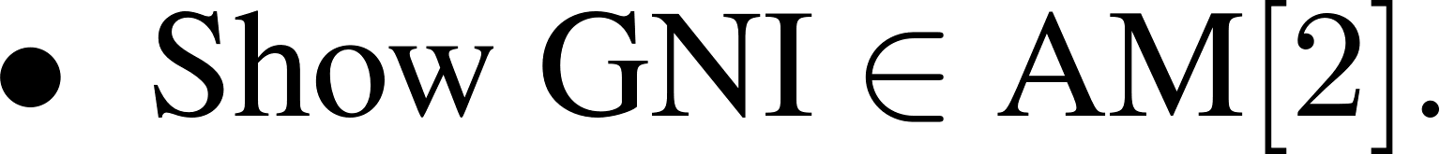


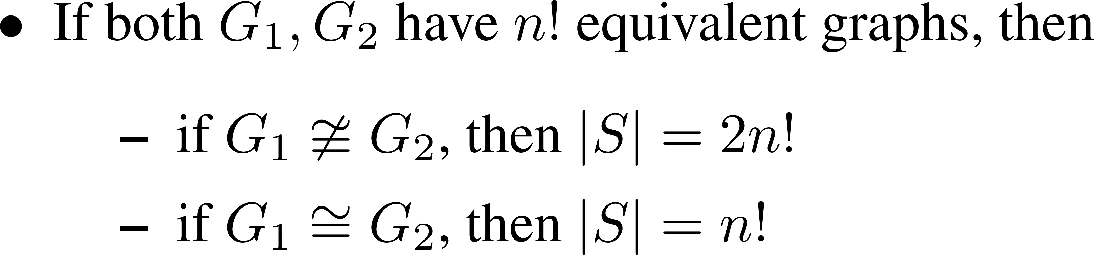
AM for GNI

Slide 10
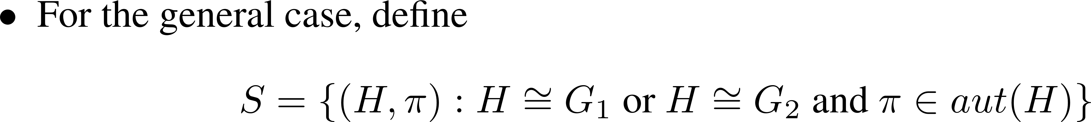
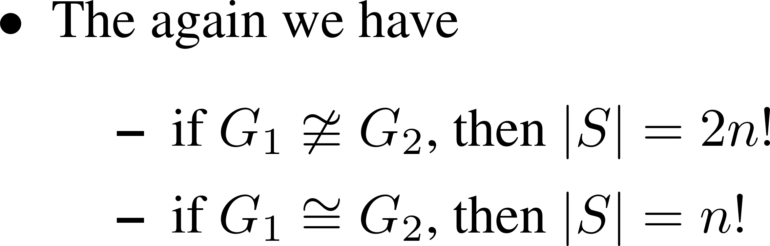

AM for GNI

Slide 11




Set Lower Bound Protocol

Slide 12
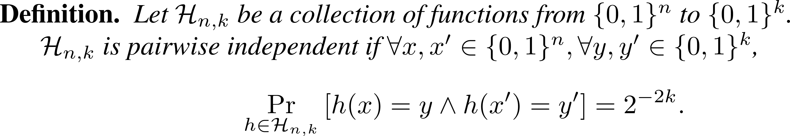

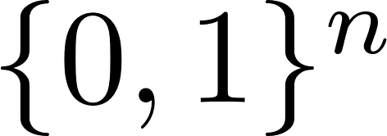
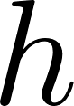
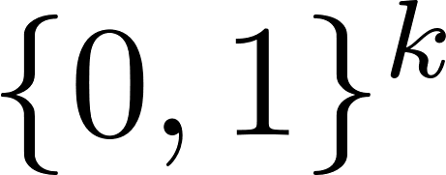

Tool: Pairwise Independent Hash Functions

Slide 13




Pairwise Independent Hash Functions Construction

Slide 14


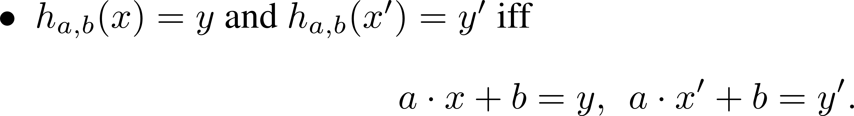


Pairwise Independent Hash Functions Analysis

Slide 15



Pairwise Independent Hash Functions Analysis

Slide 16





The Set Lower Bound Protocol

Slide 17
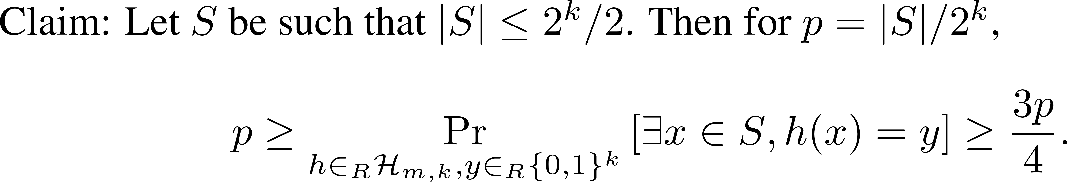



Analysis

Slide 18




Analysis

Slide 19
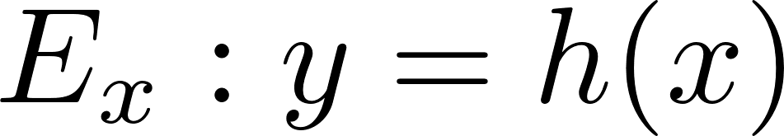



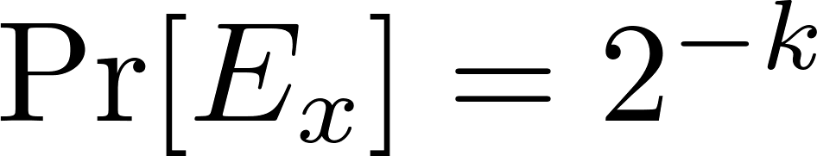
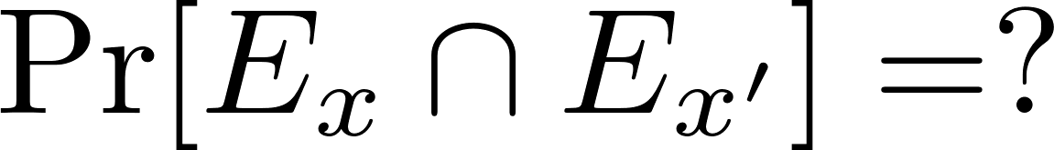


Analysis

Slide 20
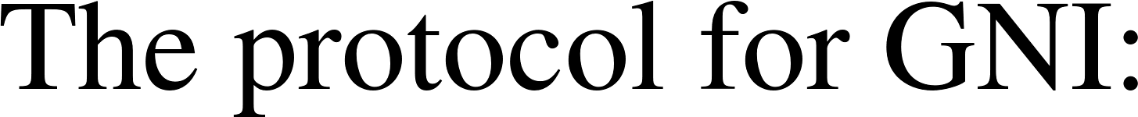
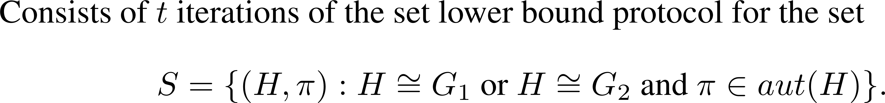



Analysis

Slide 21



Analysis

Slide 22
IP[k] is a subset of AM[k+2]
The proof is carried out using the set lower bound
The key observation is to consider the sample space of the private random coin.
There is a gap between the completeness probability and soundness error
The whole proof is left as an offline reading task.
http://www.cs.toronto.edu/tss/files/papers/goldwasser-Sipser.pdf

